Slide 1




GAME
PROJECTS
GROUP 14
VIRUS CITY
Make our city clean again with the doctor !!

Slide 2
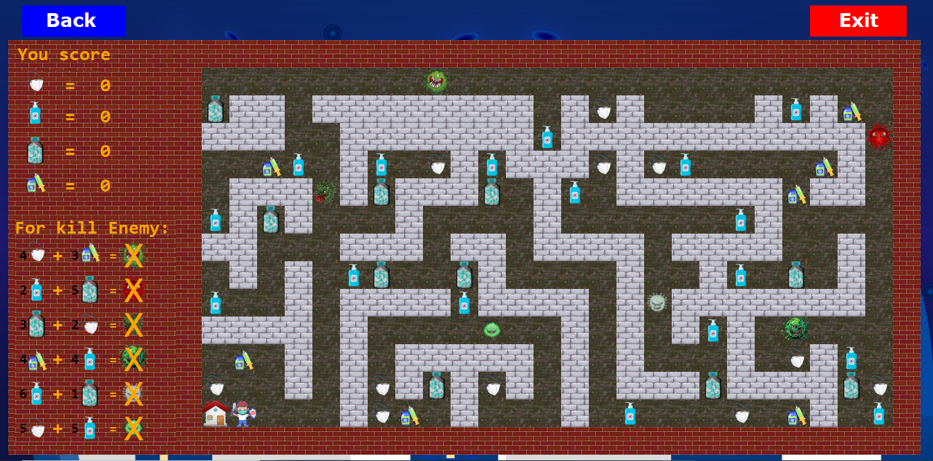
GAME STORY
Hello am virus
Hello am doctor
Hay

Slide 3
GAME OBJECTIVE
Doctor need to pick up all item and go to kill enemy by run to meet it and than he go to hospital.
He need to pick up item: Alcohol Vaccine Medicine and Mask
When you have enough Alcohol Vaccine Medicine and Mask you can go to meet enemy and kill it .
Item increase point and bad choices make you death!
Hay

Slide 4
GAME PLAY
Exit button
Back to choose level
Increase point
Use KEYS to move up, down ,left ,right
Hay
instruction

Slide 5
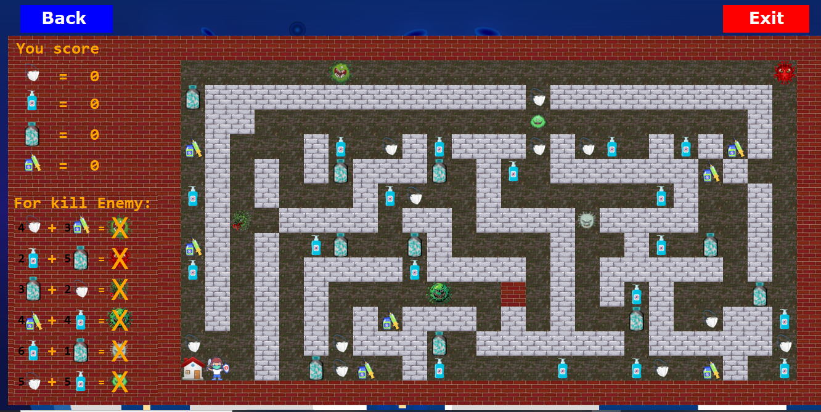
GAME LEVEL
LEVEL 2
LEVEL 1
Change grid and place of enemy
The game ends when : doctor kill all enemy and go to hospital
Hay

Slide 6
What do we learn while playing our game?
GOOD FOR THE PLAYER
Know about how to protect yourself from Covid and how to kill it
Hay

Slide 7
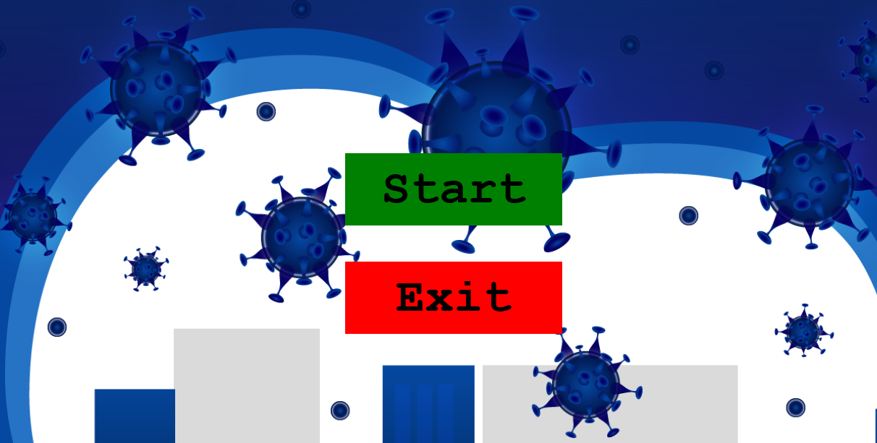

GAME DEMO
Let’s demo the game
Hay

Slide 8
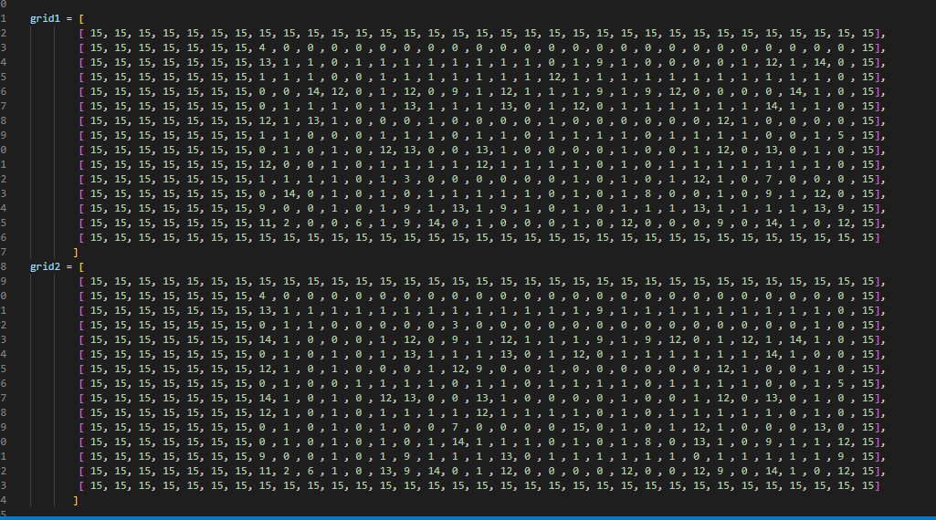
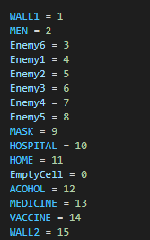

TECH
DATA STRUCTURE
Our game data structures :
Grid items
Vin

Slide 9
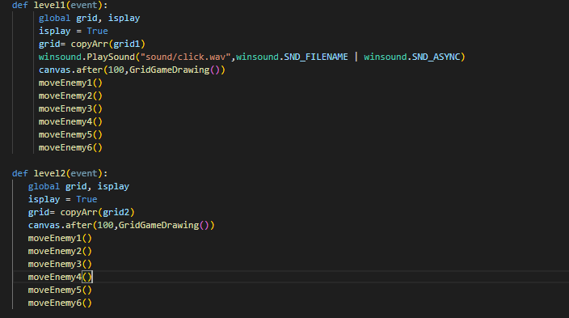

Level in game
Vin

Slide 10
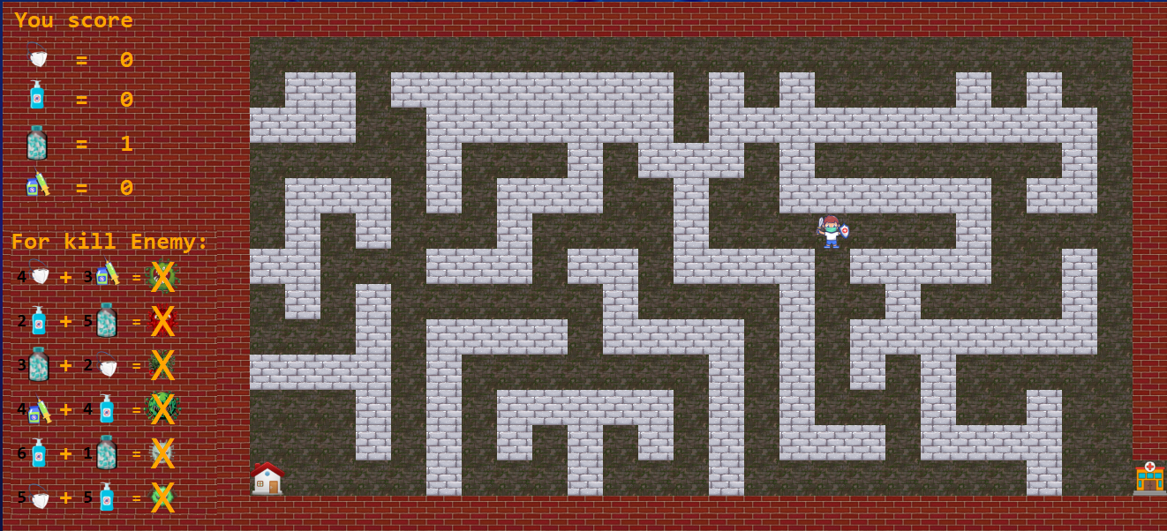
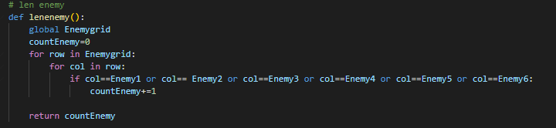

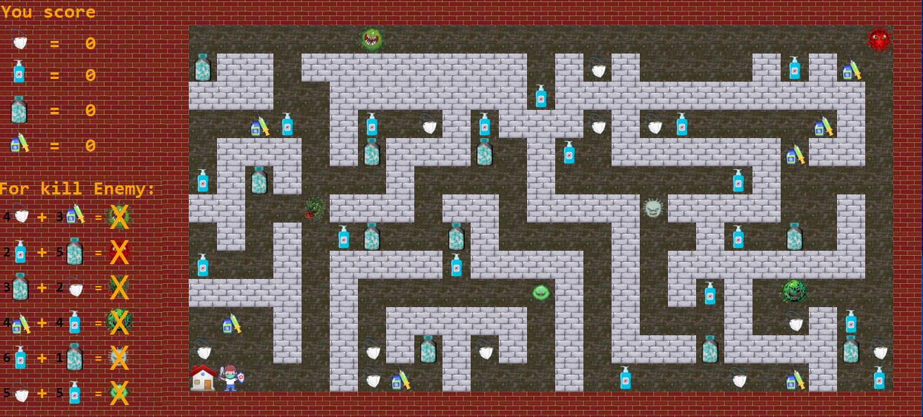
Hospital
Vin

Slide 11
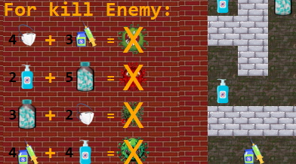
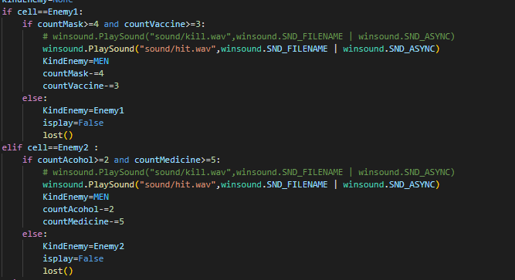
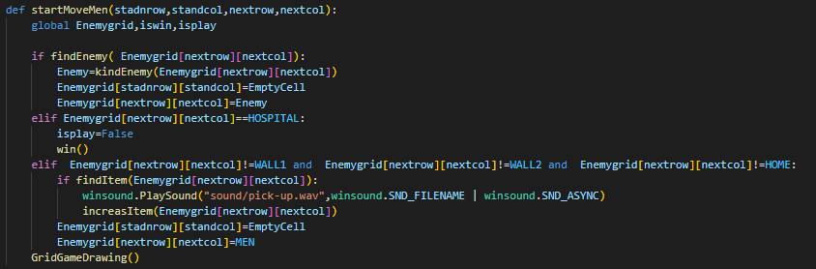
Kill Enemy
Vin

Slide 12
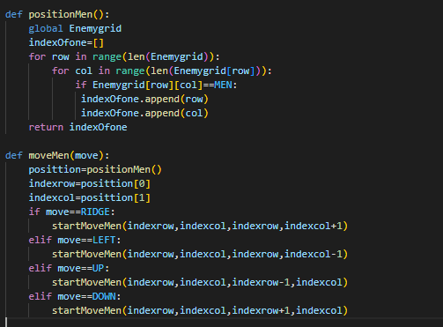
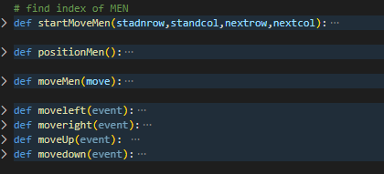
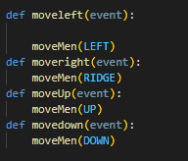
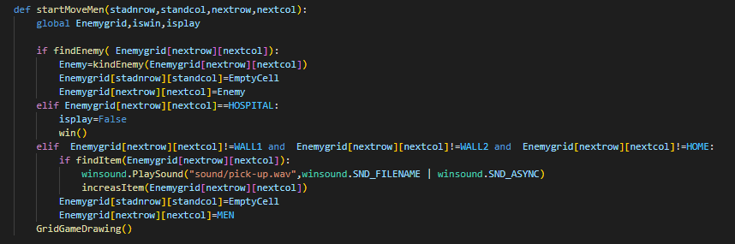
How to get doctor position
Vin

Slide 13
Thank You🙏🏼

